Slide 1
Dimensionality Reduction
and Measurement Reconstruction
for Time-Lapse Fiber-Optic Sensing
Misael M. Morales,
Carlos Torres-Verdín, and Michael J. Pyrcz
The University of Texas at Austin

Slide 2
Table of Contents
Introduction and Motivation
Fiber-Optic Sensing
Experimental System
Technical Challenges for In Situ Monitoring
Dimensionality Reduction Techniques
Results and Discussion
Conclusions and Future Work
2

Slide 3
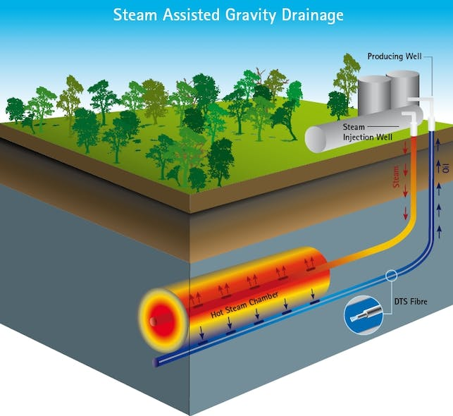
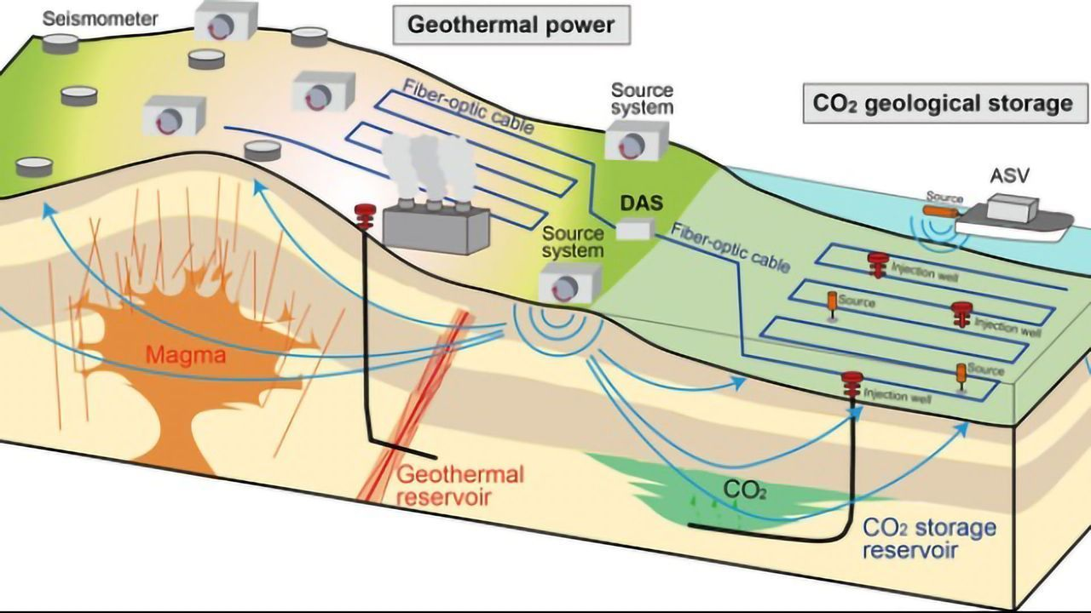
Introduction and Motivation
Digital revolution allows better subsurface profiling
Data science techniques help processing and interpretation
Fiber optics allows for reliable, cost-effective, and detailed monitoring
Applications in geothermal, CCUS, hydraulic fracturing, EOR, etc.
→ Large volumes of data
Maio et. al. (2010)
Tsuji et. al. (2021)
3

Slide 4
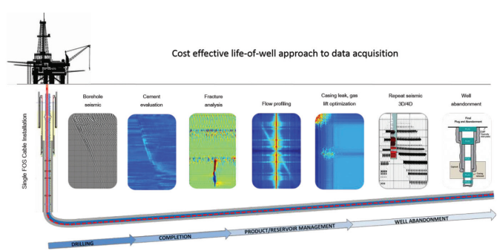
Fiber-Optic Sensing
Cost-effective and high-resolution alternative for downhole monitoring
Distributed Acoustic Sensing (DAS)
Measurement of axial strain rate along the fiber
Advantages:
No moving parts
No downhole electronics
Deployed throughout wellbore
Naldrett et. al. (2018)
4

Slide 5

Experimental System: Flow Loop Design
50-meter flow loop with internal and external tubing:
Background + 4 perforations flowing O/G/W
Fiber optic cable in annulus recording DAS & DTS
In collaboration with:
Injection points
Background:
O – 3,000
W – 0
G- 100,000
1
2
3
4
F.O. cable
5,504 measurements
13 minutes @ 10 kHz
Injection 1:
O – 250
W – 250
G – 8,333.3
Injection 2:
O – 250
W – 100
G – 8,333.3
Injection 3:
O – 0
W – 0
G – 0
Injection 4:
O – 250
W – 250
G – 8,333.3
5

Slide 6
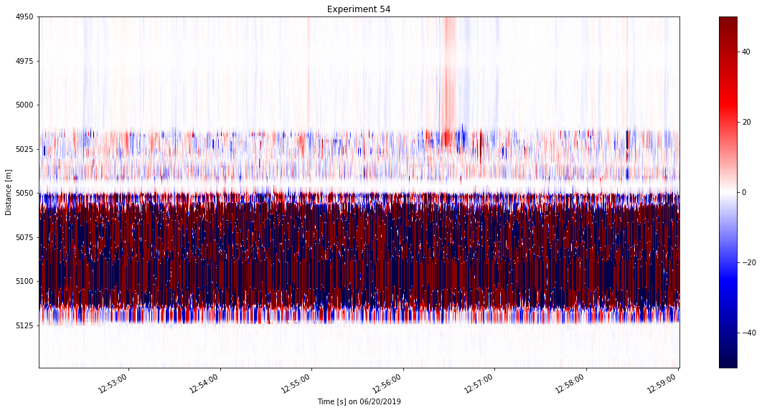
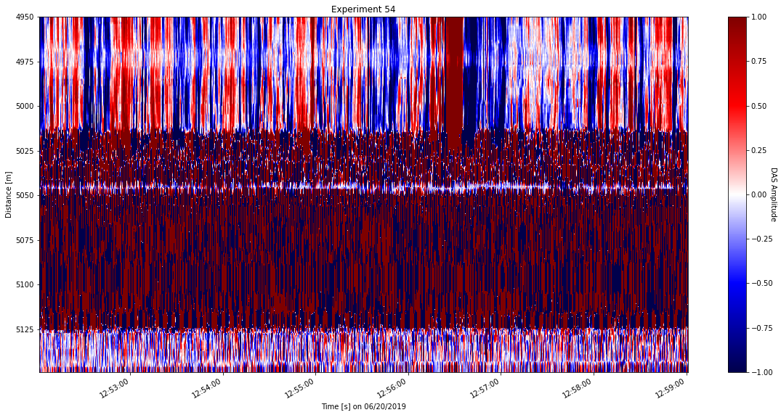
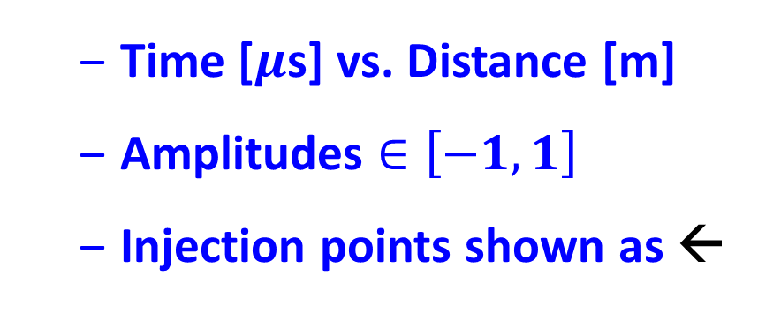
Experimental System: DAS Data Acquisition
Time-lapse DAS response along the flowloop
In collaboration with:
Time [$μ$s] vs. Distance [m]
Amplitudes $∈\left[−1,1\right]$
Injection points shown as ←
100 Gb of DAS data in “.h5”
Compress to 1.56 Gb “.pkl”
5504 m → 200 m
13 minutes → 7 minutes
6

Slide 7
Technical Challenges for In Situ Monitoring
Data from Fiber-Optic sensing can be hard to use
Sensitivity to noise
Sensor reliability
Event detection in real time
Data volume: 200 Mbps interrogator, 1 Mbps cloud → 0.5% CR
Data-driven techniques allow for improved processing and analysis
Reduced-dimensional space for efficient compression, interpretation, and reconstruction
7

Slide 8
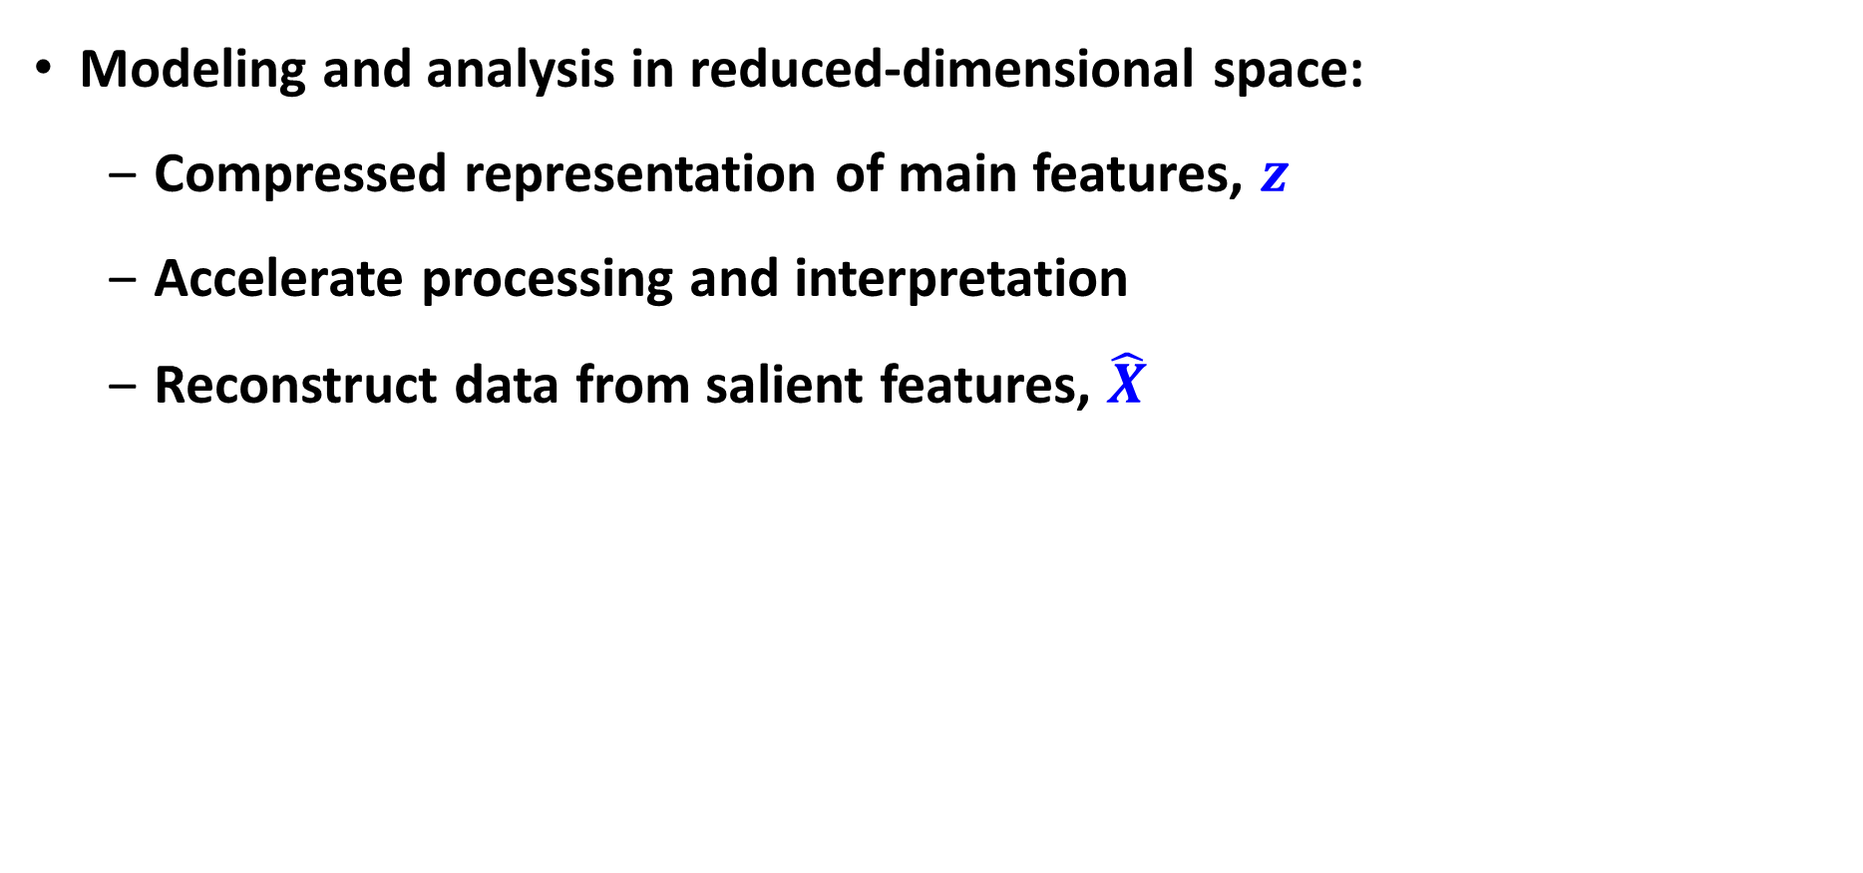


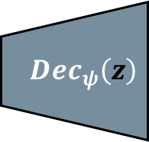
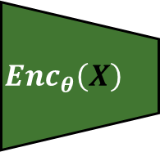
Dimensionality Reduction Techniques: Overview
Modeling and analysis in reduced-dimensional space:
Compressed representation of main features, $z$
Accelerate processing and interpretation
Reconstruct data from salient features, $\hat{X}$
Original
Data
$$X$$
$$Enc_{θ}\left(X\right)$$
$$Dec_{ψ}\left(z\right)$$
Reconstructed Data
$$\hat{X}$$
z
8

Slide 9
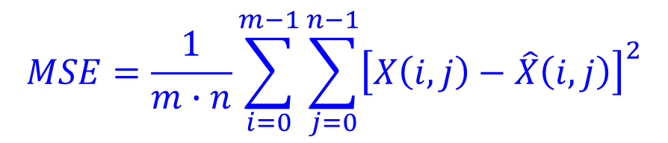
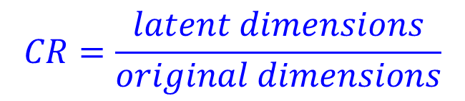
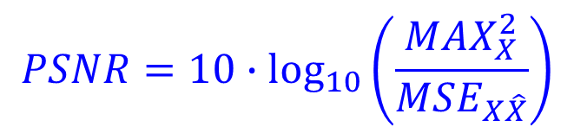
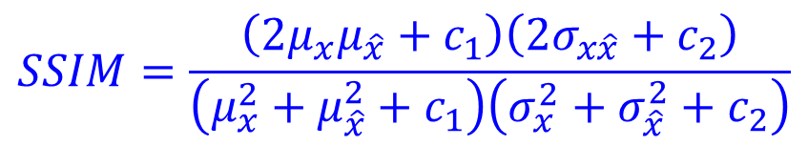
Dimensionality Reduction Techniques: Methods and Metrics
SVD, PCA, FFT, DWT, and Deep Learning AutoEncoders
Compared at different compression ratios:
Error metrics:
Mean squared error:
Structural similarity index measure:
Peak signal-to-noise ratio:
$$CR=\frac{latent dimensions}{original dimensions}$$
$$MSE=\frac{1}{m∙n}\sum_{i=0}^{m−1}{\sum_{j=0}^{n−1}{{\left[X\left(i,j\right)−\hat{X}\left(i,j\right)\right]}^{2}}}$$
$$SSIM=\frac{\left(2μ_{x}μ_{\hat{x}}+c_{1}\right)\left(2σ_{x\hat{x}}+c_{2}\right)}{\left(μ_{x}^{2}+μ_{\hat{x}}^{2}+c_{1}\right)\left(σ_{x}^{2}+σ_{\hat{x}}^{2}+c_{2}\right)}$$
$$PSNR=10∙\log_{10}\left(\frac{MAX_{X}^{2}}{MSE_{X\hat{X}}}\right)$$
9

Slide 10
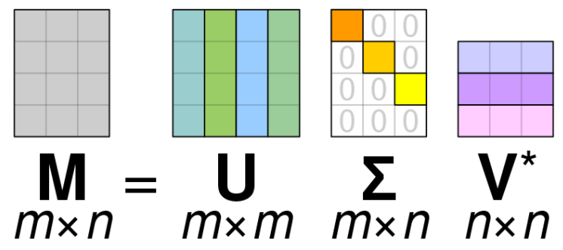
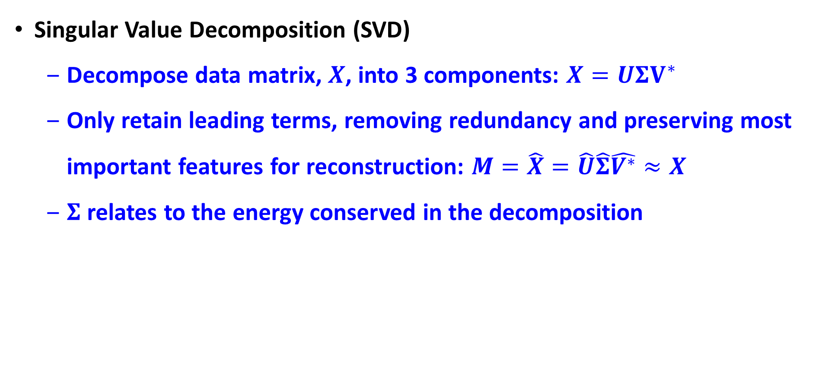
Dimensionality Reduction Techniques: SVD
Singular Value Decomposition (SVD)
Decompose data matrix, $X$, into 3 components: $X=UΣV^{∗}$
Only retain leading terms, removing redundancy and preserving most important features for reconstruction: $M=\hat{X}=\hat{U}\hat{Σ}\hat{V^{∗}}≈X$
$Σ$ relates to the energy conserved in the decomposition
From Wikipedia, SVD
10

Slide 11
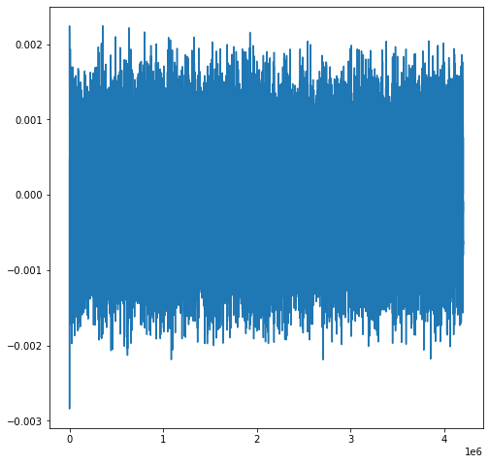
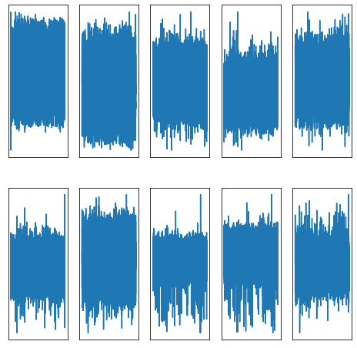
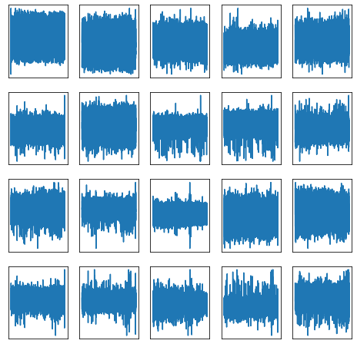
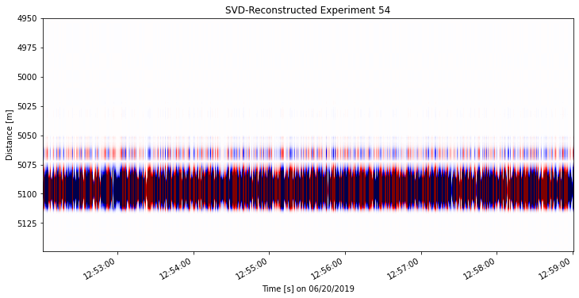
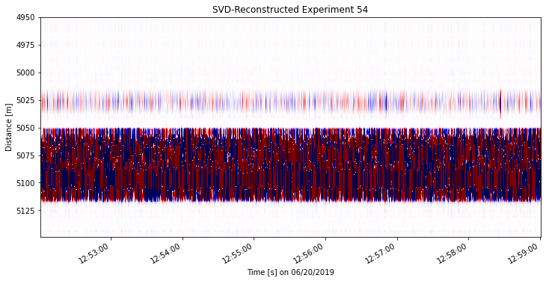
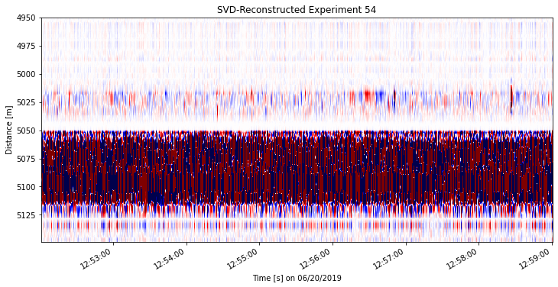
Dimensionality Reduction Techniques: SVD
0.5% CR
5% CR
10% CR
MSE: 1.45e-3
SSIM: 79.40%
PSNR: 34.40 dB
MSE: 2.85e-4
SSIM: 94.68%
PSNR: 41.90 dB
MSE: 1.61e-4
SSIM: 97.37%
PSNR: 43.96 dB
11

Slide 12
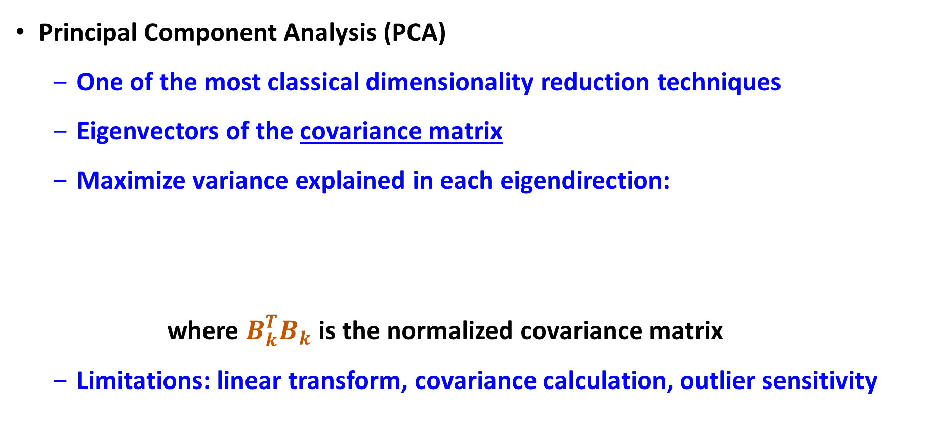

Dimensionality Reduction Techniques: PCA
Principal Component Analysis (PCA)
One of the most classical dimensionality reduction techniques
Eigenvectors of the covariance matrix
Maximize variance explained in each eigendirection:
where $B_{k}^{T}B_{k}$ is the normalized covariance matrix
Limitations: linear transform, covariance calculation, outlier sensitivity
$$v_{k}=argmax\frac{u_{k}^{T}{\hat{B_{k}}}^{T}\hat{B_{k}}u_{k}}{u_{k}^{T}u_{k}}$$
12

Slide 13
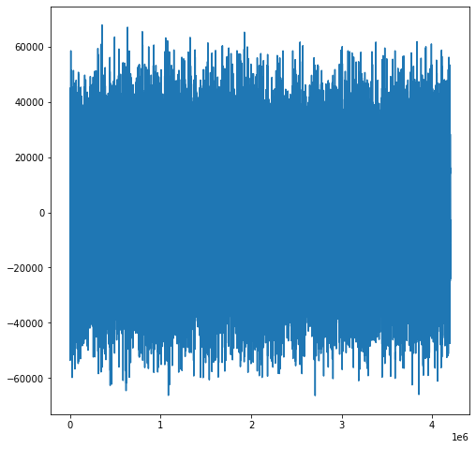
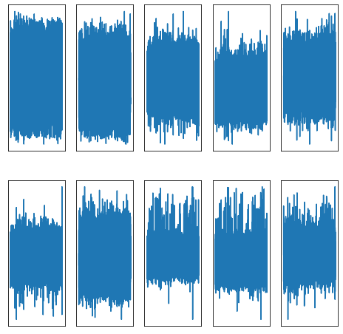
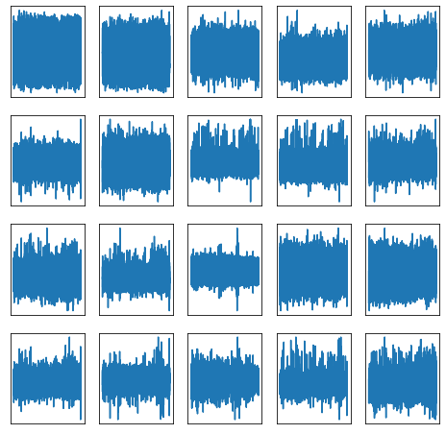
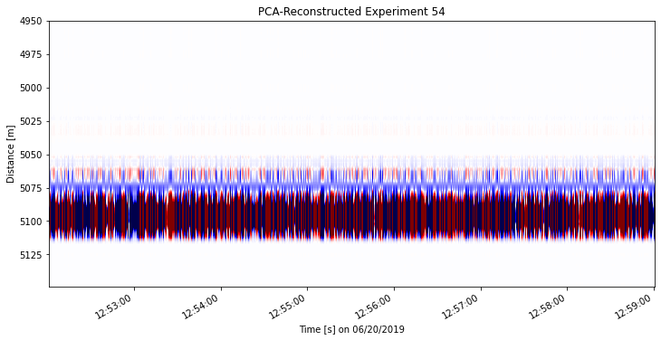


Dimensionality Reduction Techniques: PCA
0.5% CR
5% CR
10% CR
MSE: 1.40e-3
SSIM: 79.54%
PSNR: 34.54 dB
MSE: 1.55e-4
SSIM: 95.49%
PSNR: 44.12 dB
MSE: 8.06e-5
SSIM: 97.91%
PSNR: 46.96 dB
13

Slide 14
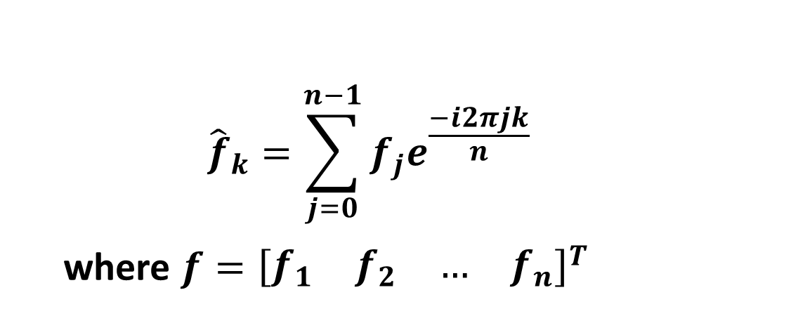
Dimensionality Reduction Techniques: FFT
Fast Fourier Transform (FFT)
Uses generic basis of sines/cosines from eigenvectors of data matrix
Retains a range of frequency components in the data by shifting from time-space to frequency-wavenumber domain
$${\hat{f}}_{k}=\sum_{j=0}^{n−1}{f_{j}e^{\frac{−i2πjk}{n}}}$$
where $f={\left[\begin{matrix}f_{1} & f_{2} & … & f_{n}\end{matrix}\right]}^{T}$
14

Slide 15
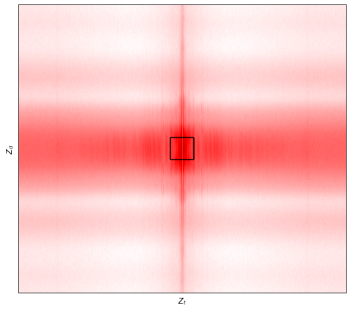
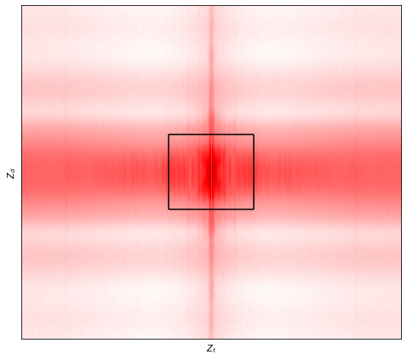
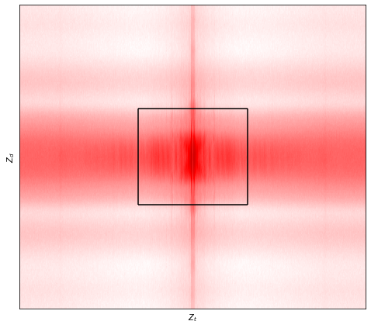
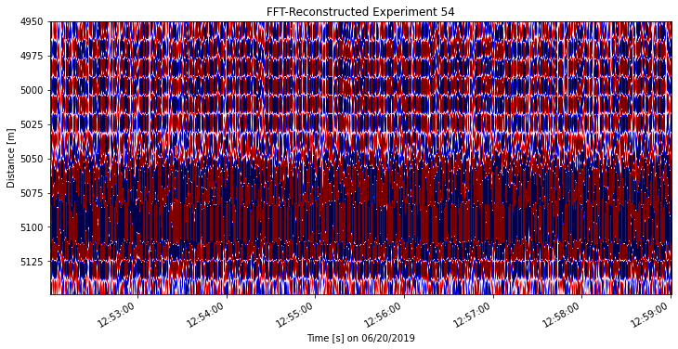
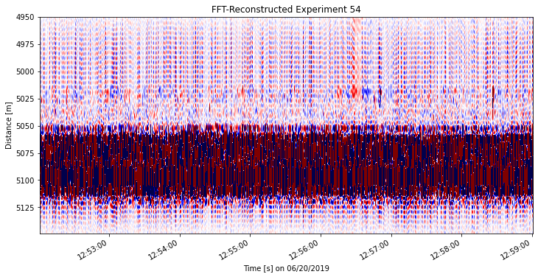
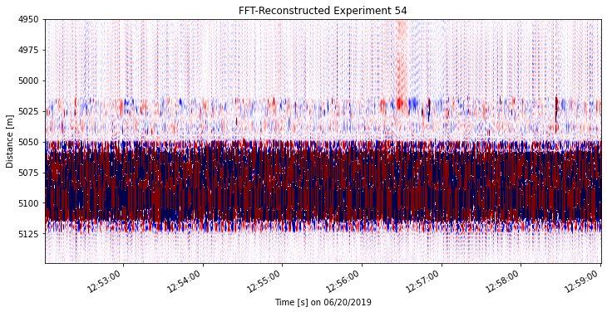
Dimensionality Reduction Techniques: FFT
0.5% CR
5% CR
10% CR
MSE: 1.39e-2
SSIM: 77.15%
PSNR: 34.59 dB
MSE: 3.79e-4
SSIM: 94.24%
PSNR: 40.24 dB
MSE: 3.26e-4
SSIM: 95.01%
PSNR: 40.89 dB
15

Slide 16
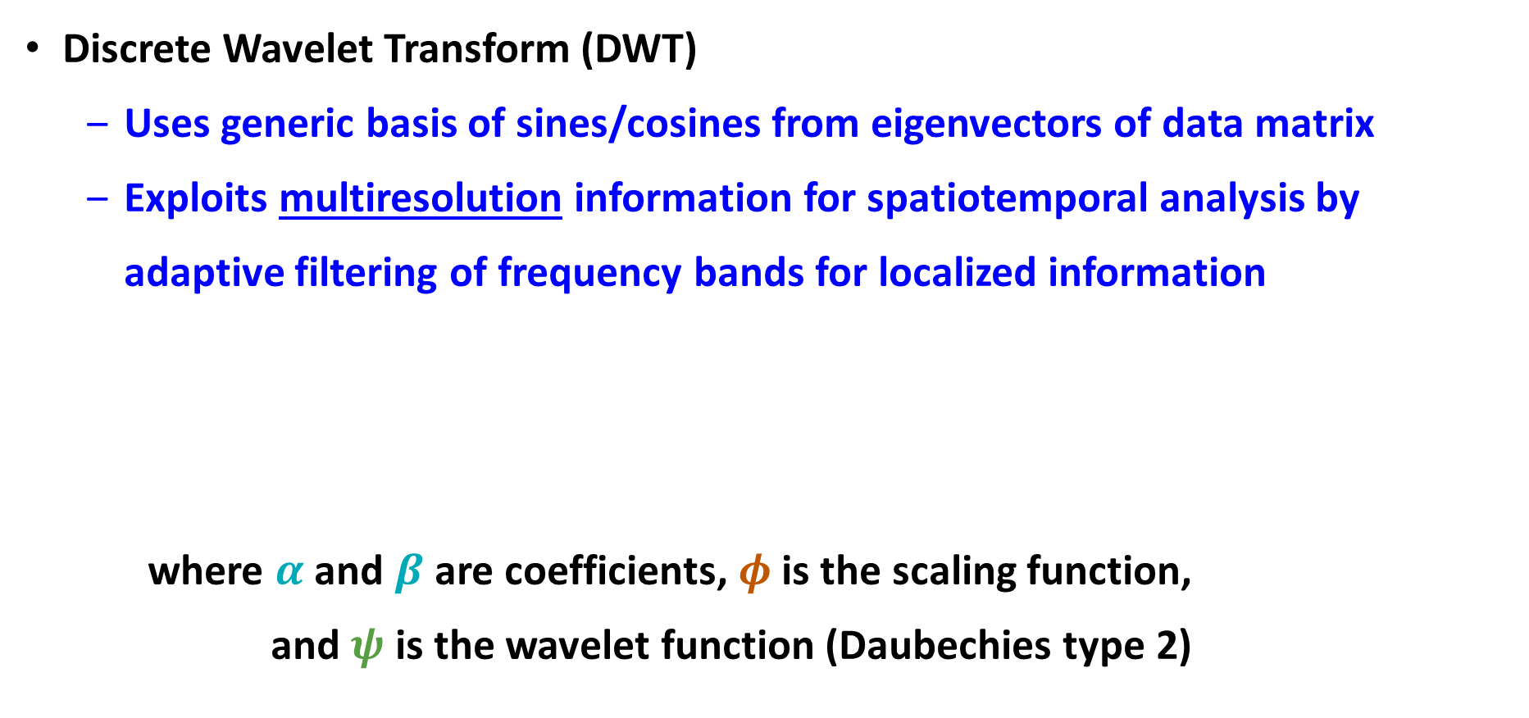

Dimensionality Reduction Techniques: DWT
Discrete Wavelet Transform (DWT)
Uses generic basis of sines/cosines from eigenvectors of data matrix
Exploits multiresolution information for spatiotemporal analysis by adaptive filtering of frequency bands for localized information
where $α$ and $β$ are coefficients, $φ$ is the scaling function,
and $ψ$ is the wavelet function (Daubechies type 2)
$${\hat{f}}_{k}\left(t\right)=\sum_{k=−∞}^{∞}{a_{k}φ\left(t\right)}+\sum_{k=−∞}^{∞}{\sum_{j=0}^{∞}{β_{j,k}ψ\left(t\right)}}$$
16

Slide 17
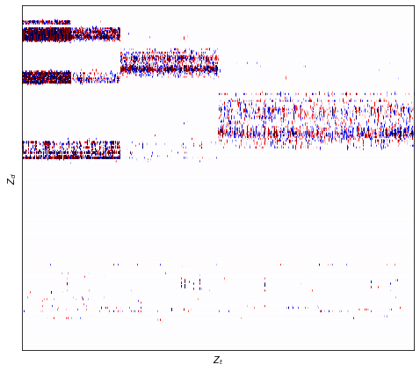
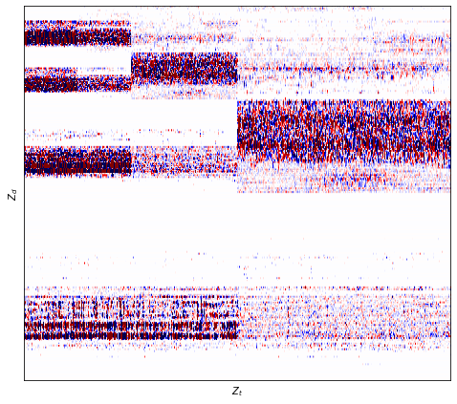
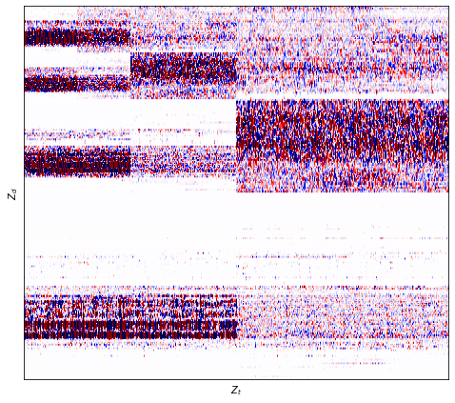
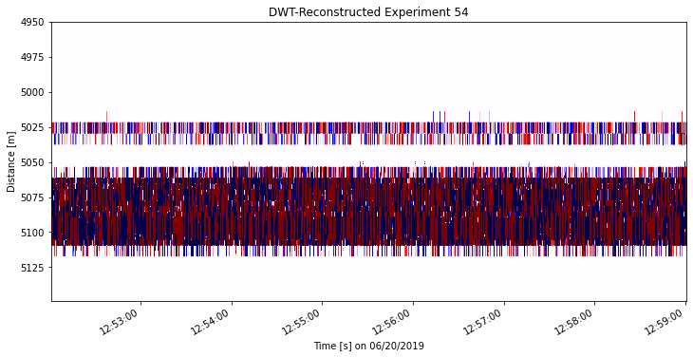
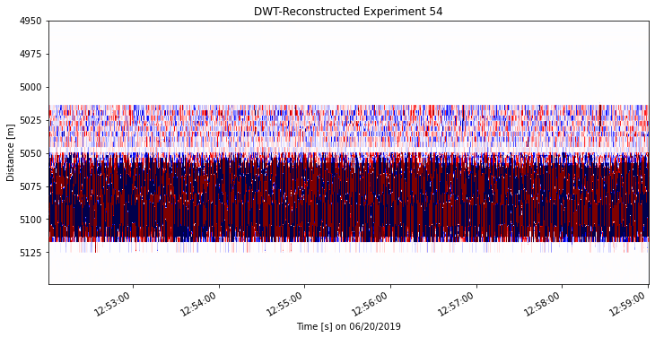
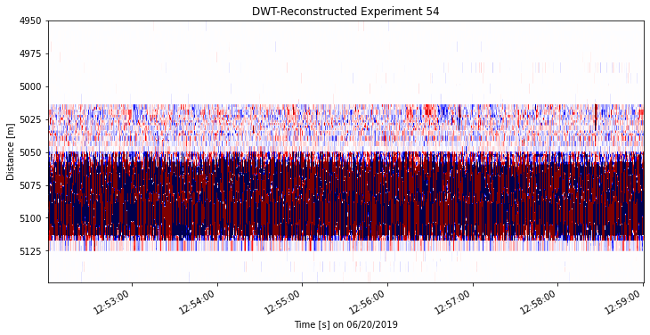
Dimensionality Reduction Techniques: DWT
0.5% CR
5% CR
10% CR
MSE: 4.98e-4
SSIM: 88.02%
PSNR: 39.05 dB
MSE: 1.28e-4
SSIM: 96.71%
PSNR: 44.95 dB
MSE: 6.89e-5
SSIM: 98.17%
PSNR: 47.64 dB
17

Slide 18
Dimensionality Reduction Techniques: DL-AE
Deep Learning AutoEncoders
Recent advanced in computing power allow for powerful models for advanced dimensionality reduction and data reconstruction
Variety of styles and architectures can be designed:
Fully-Connected Neural Networks (FCNN)
Convolutional Neural Networks (CNN)
Variational, Recurrent, Adversarial, etc. …
18

Slide 19
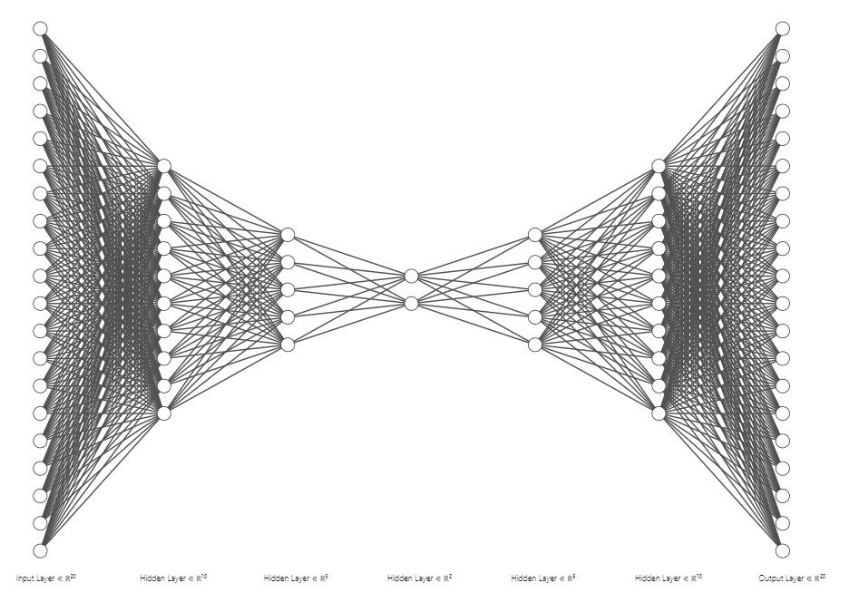
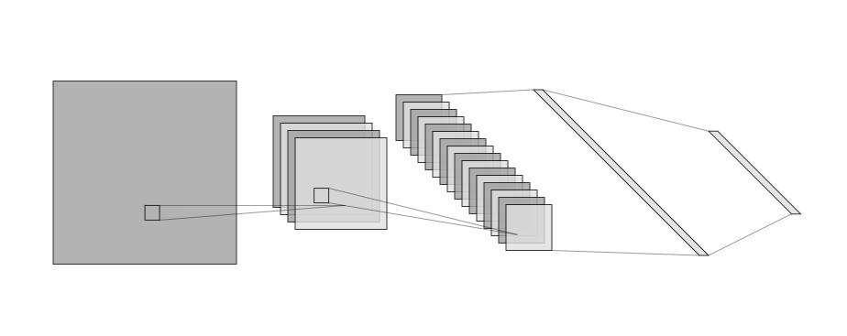
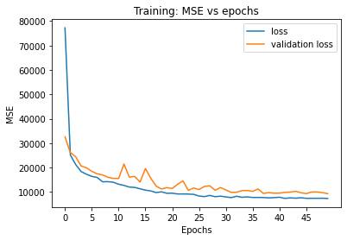
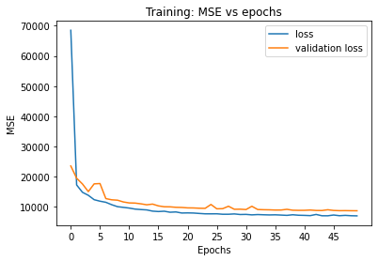
Dimensionality Reduction Techniques: DL-AE
Fully-Connected NN
Convolutional NN
Activation = PReLU
Optimizer = Adam
Loss = MSE
Epochs = 50
# Params: 102,820
# Params: 171,677
19
Notes:
NVIDIA M6000

Slide 20
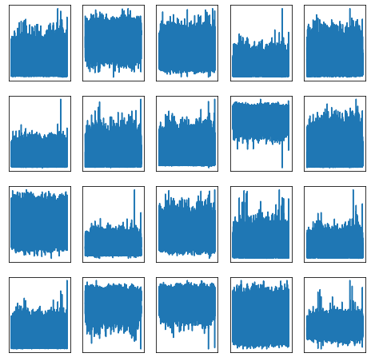
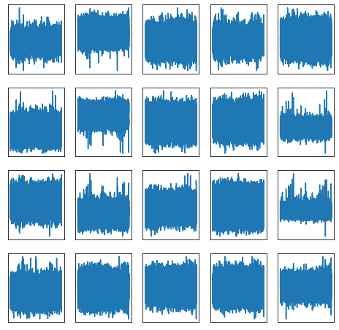
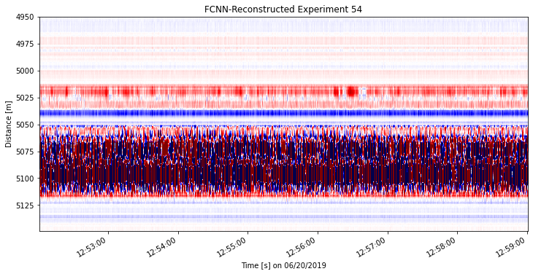
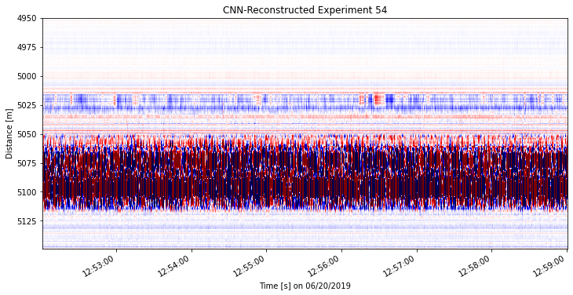
Dimensionality Reduction Techniques: DL-AE
FCNN – 5% CR
CNN – 5% CR
MSE: 1.97e-2
SSIM: 65.45%
PSNR: 27.32 dB
MSE: 1.52e-2
SSIM: 70.03%
PSNR: 34.18 dB
20

Slide 21
Results and Discussion: Error Metrics
Comparison of error metrics for dimensionality reduction techniques
Technique | Computing Time | Latent Dimension | MSE [] | SSIM [%] | PSNR [dB]
SVD | 6m 54s | 5% | 2.85-4 | 94.68 | 41.90
PCA | 7m 8s | 5% | 1.55e-4 | 95.49 | 44.12
FFT | 7m 20s | 5% | 3.79e-4 | 94.24 | 40.24
DWT | 6m 28s | 5% | 1.28e-4 | 96.71 | 44.95
DL-AE FCNN | 5m 14s | 5% | 1.97e-2 | 65.45 | 27.32
DL-AE CNN | 12m 16s | 5% | 1.52e-2 | 70.03 | 34.18
21

Slide 22
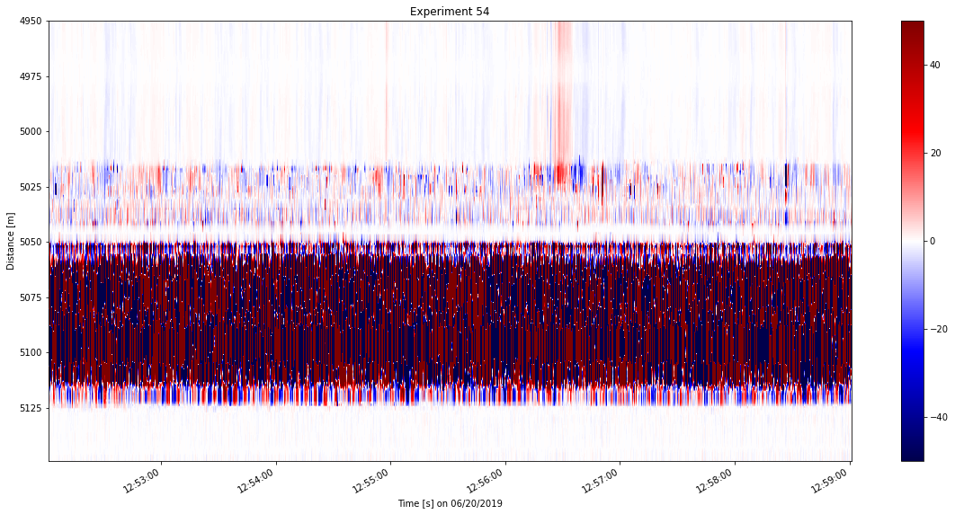
Results and Discussion: Reconstruction Efficiency
Comparison of reconstructions at 5% compression ratio
22

Slide 23
Results and Discussion: Latent Space Interpretation
PCA and SVD: may not be best-suited for time series
Do not represent all physics in the dynamical system
FFT and DWT: best exploit time signals but generic basis are not tailored to physics in the data
Leading methods for image/video processing
Deep Learning AutoEncoders:
Require expertise in design and training but incorporate all physics and dynamics in the time series data
23

Slide 24
Conclusions and Future Work
Classical techniques have up to 95% SSIM at 5% CR
Deep learning techniques have up to 70% SSIM at 5% C.R.
Further tuning and training required to improve models
In the future:
Use flowrates and Distributed Temperature Sensing data in latent vector
Event detection and classification in latent space
Noise suppression and enhanced data compression and reconstruction
24

Slide 25

Acknowledgements
25

Slide 26
References
[1] Mateeva, A., Lopez, J., Chalenski, D., Tatanova, M., Zwartjes, P., Yang, Z., Bakku, S., de Vos, K., and Potters, H., 2017, “4D DAS VSP as a tool for frequent seismic monitoring in deep water”, Leading Edge, Tulsa, Oklahoma, v. 36, n. 12, p. 995-1000.
[2] Zwartjes, P., Mateeva, A., Chalenski, D., Duan, Y., Kiyashchenko, D., and Lopez, J., 2018, “Frequent, multi-well, stand-alone 3D DAS VSP for low-cost reservoir monitoring in deepwater”, SEG International Exposition and Annual Meeting, Anaheim, California, October.
[3] Luo, B., Lellouch, A., Jin, G., Biondi, B., and Simmons, J., 2021, “Seismic inversion of shale reservoir properties using microseismic-induced guided waves recorded by distributed acoustic sensing”, Geophysics, v. 86, n. 4, p. R383-R397.
[4] Liu, F., Huff, O., Luo, B., Jin, G., and Simmons, J., 2022, “Convolutional neural network-based classification of microseismic events originating in a stimulated reservoir from distributed acoustic sensing data”, Geophysical Prospecting, v. 70, n. 5, p. 904-920.
[5] Feng, Q., and Li, Y., 2022, “Denoising deep learning network based on singular spectrum analysis – DAS seismic denoising with multichannel SVDDCNN”, IEEE Transactions on Geoscience and Remote Sensing, v. 60, p. 1-11.
[6] Binder, G., and Tura, A., 2020, “Convolutional neural network for automated microseismic detection in downhole distributed acoustic sensing data and comparison to a surface geophone array”, Geophysical Prospecting, v. 68, n. 9, p. 2770-2782.
[7] Zhong, T., Cheng, M., Lu, S., Dong, X., and Li, Y., 2022, “RCEN: a deep-learning-based background noise suppression method for DAS-VSP records”, IEEE Geoscience and Remote Sensing Letters, v. 19, p. 1-5.
[8] Tsuji, T., Ikeda, T., Matsuura, R., Mukumoto, K., Lawrens Hutapea, F., Kimura, T., Yamaoka, K., and Shinohara, M., 2021, “Continuous monitoring system for safe managements of CO2 storage and geothermal reservoirs”, Scientific Reports, v. 11, n. 1, p. 19120-19120.
[9] Maio, V., Gribik, A., Patterson, M., and Boardman, R., 2010, “Nuclear-integrated oil sands recovery via steam-assisted gravity drainage”, Idaho National Lab Reports, n. 23843, p. 8-12.
[10] Naldrett, G., Cerrahoglu, C., and Mahue, V., 2018, “Production monitoring using next-generation distributed sensing systems”, Petrophysics, v. 59, n. 4, p. 496-510.
26

Slide 27
Thank You
Q & A

Slide 28
Backup Slides

Slide 29
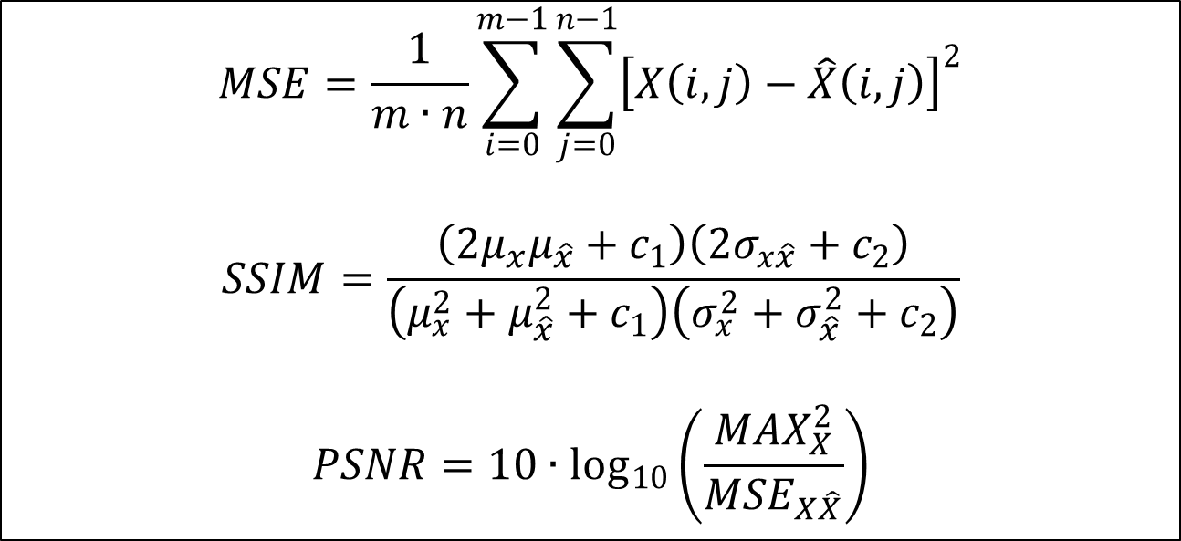

Backup Slides
$$MSE=\frac{1}{m∙n}\sum_{i=0}^{m−1}{\sum_{j=0}^{n−1}{{\left[X\left(i,j\right)−\hat{X}\left(i,j\right)\right]}^{2}}}$$
$$SSIM=\frac{\left(2μ_{x}μ_{\hat{x}}+c_{1}\right)\left(2σ_{x\hat{x}}+c_{2}\right)}{\left(μ_{x}^{2}+μ_{\hat{x}}^{2}+c_{1}\right)\left(σ_{x}^{2}+σ_{\hat{x}}^{2}+c_{2}\right)}$$
$$PSNR=10∙\log_{10}\left(\frac{MAX_{X}^{2}}{MSE_{X\hat{X}}}\right)$$
where $X$ is the original data matrix,
$\hat{X}$ is the reconstruction matrix,
and $c_{1}$ and $c_{2}$ are small stability constants
29

Slide 30


Backup Slides
ReLU PReLU
Rectified Linear Unit Parametric Rectified Linear Unit
Where $α$ is a learned array with the same shape as $X$,
and is initialized as zeros (ReLU)
30

